Slide 1
FYP5: Object Detection, Tracking and Suspicious Activity Recognition for Maritime Surveillance using Thermal Vision

Slide 2
Update on the Research
Establishment of the mathematical reasoning behind the custom block proposed
Shift from TensorFlow to Pytorch
Reason to switch
TensorFlow Object Detection API does not support the stateful implementation which is major variant of our models
The evaluation code that was provided throws errors when the batch size increased > 1. - Not have been resolved in the community as well

Slide 3
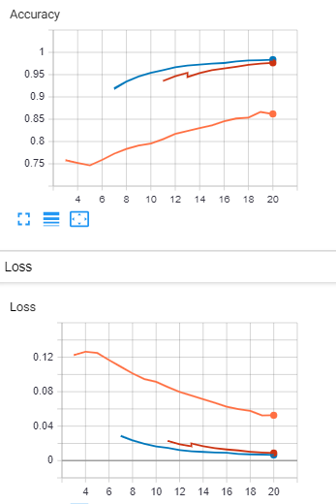
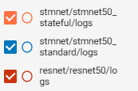
Current Progress
Completed the coding of the state-full and state-less backbone custom architecture
Trained and Evaluated the models on the classification task
Finished coding the CenterNet head – Currently training and debugging the issues
Performance on Classification Task – Pytorch implementation

Slide 4
Limitations - GPU Size and Number
All CenterNet training done by research community & other online implementations are trained using batch sizes of 128 and at least 8 GPUs
Smaller batch sizes severely affect training
Must adjust learning rate and number of iterations according to change in batch size – as iterations increase training time also increases (~1 day/ epoch)
Still training CenterNet with ResNet backbone (Original implementation) on our dataset to verify results

Slide 5

Tasks for next week
Experimenting with different Object Detection Heads

